Slide 1


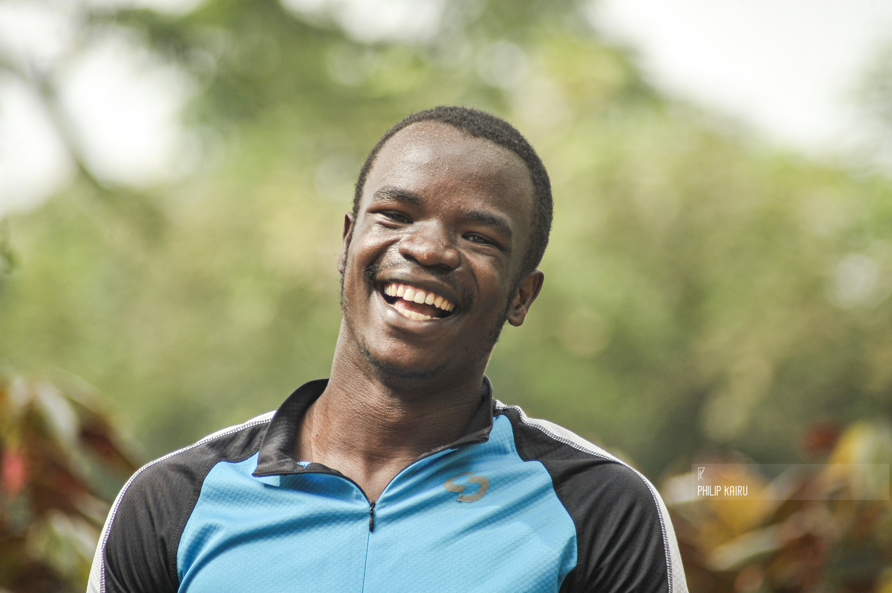


Timothy Ongaba
MSc. Biomedical Sciences
Nottingham Trent University
Bioinformatics screening in the treatment of Prostate Cancer

Slide 2
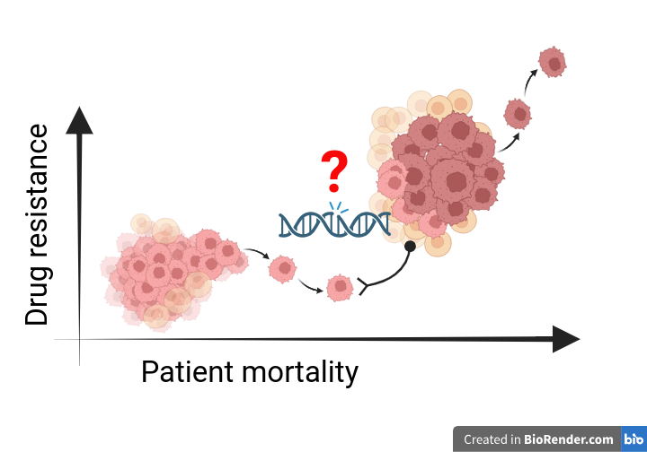



Verbal Business Card
My intervention is to the benefit of prostate cancer patients. By screening for known and judicially annotating genetic mutation when the risk of disease increases, targeted therapies can be employed to halt disease progression/speed up recovery, improve quality of life while reducing side effects.

Slide 3

ICURe Journey
Challenges
Difficult time going past the interview stages for jobs/placements.
Imprecise at marketing myself/skills for the employer's benefit.
Limited knowledge on how to maximise LinkedIn for successful connections.
​
Improvements​
Image background for what I am interested in​
LinkedIn groups – Kath Whittaker​
Precise about section​
Intentional messaging to new connections – Quentin C.B ​
Employed my VBC highlighting my benefit to employers

Slide 4
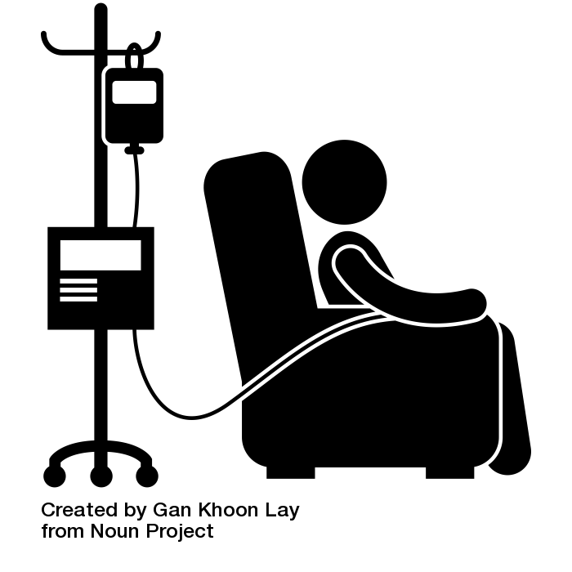
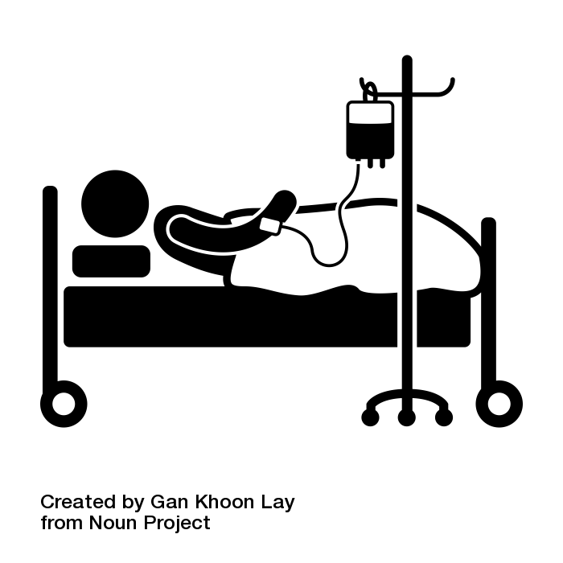
Research Problem
Conventional chemotherapeutic drugs are associated with side effects, slow recovery rates and drug resistance leading to aggressive recurrences.
Continued disease burden has longer recovery, poor quality of life and hefty economic burden

Slide 5


Solution
By pinpointing genetic factors in disease development/progression, disease trajectory can be altered using targeted therapies to short recovery time, reduced side effects and better quality of life.

Slide 6
Research on Topic
My BSc and MSc dissertations have been in line with PCa-specific gene mutations all highlighting their role in PCa.
By compiling a set of known genes and judicially inferenced ones using bioinformatic tools, more effective treatments can be used, and more lives can be saved.
The advent of bioinformatics and artificial intelligence expedites this approach. Also held into account are epigenetic factors and lifestyle modifications in the management of disease.
This service, at least in theory will improve healthcare outcomes and patient survival.

Slide 7

Appreciation
Special thanks to the entire ICURe team
The mentors
Everyone who saw this programme through

